Slide 1
Compare & Conquer™ Can you create a better flood plan?
Presented by:
Gautam Krishnan
Sai Priya Jyothula
Sumanth Reddy Pandugula

Slide 2
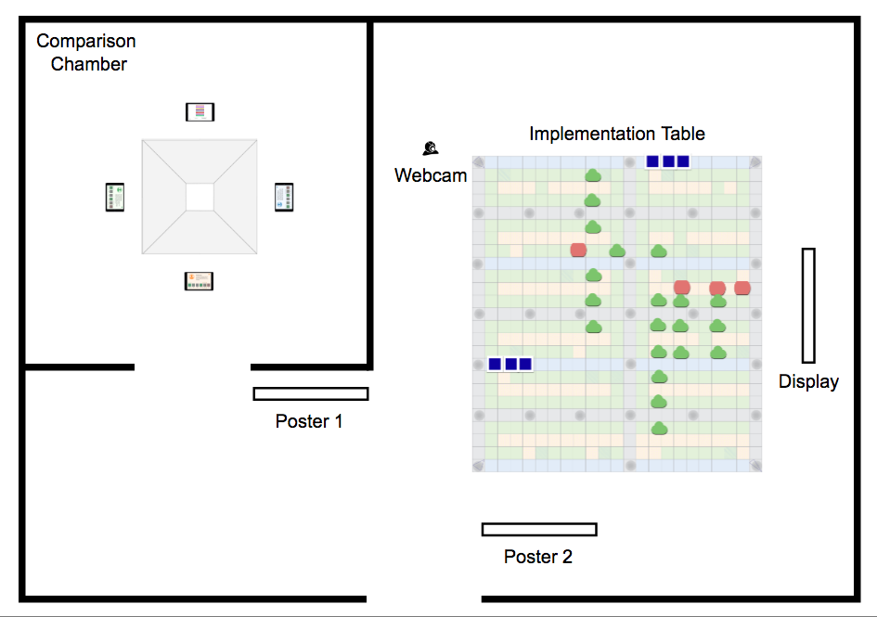
Overall Layout

Slide 3
Poster 1
Poster 2
Step 1
Welcome to Compare & Conquer. This exhibit demonstrates how you can plan your neighborhood to reduce flooding.
Compare some trials already made by politicians, pedestrians in the comparison chamber and select the trial that you think is the best.
Step 2
Implement the trial that you selected in step 1 on the table with the tokens that you find near the table.
You can customize the trial as you see fit by discussing with your group.

Slide 4
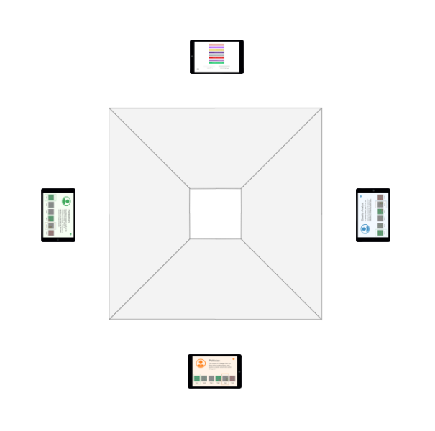
Comparison Chamber

Slide 5
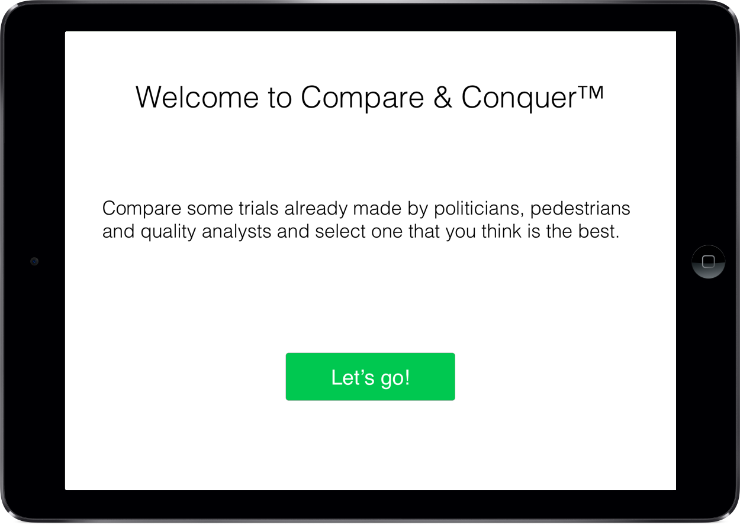
Start screen on iPads (Politician, Pedestrian and Quality Analyst)

Slide 6
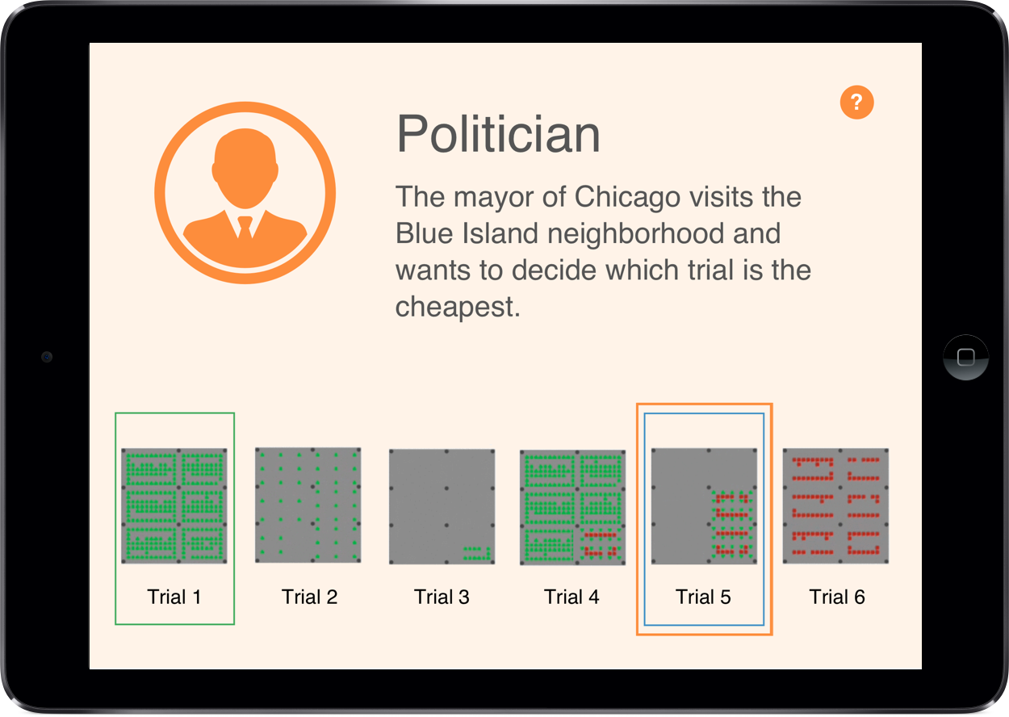
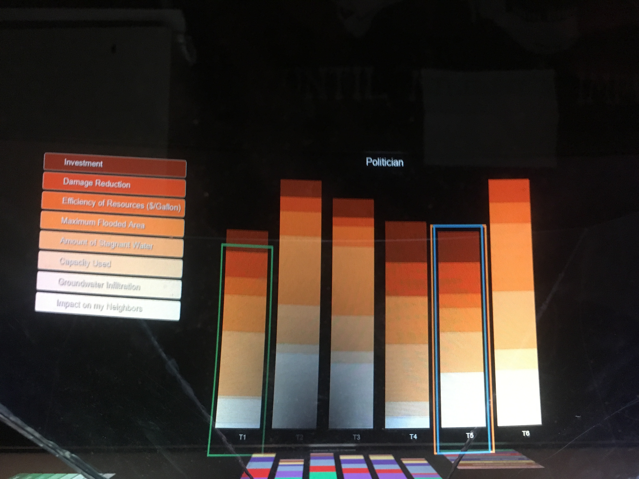
Role - Politician

Slide 7
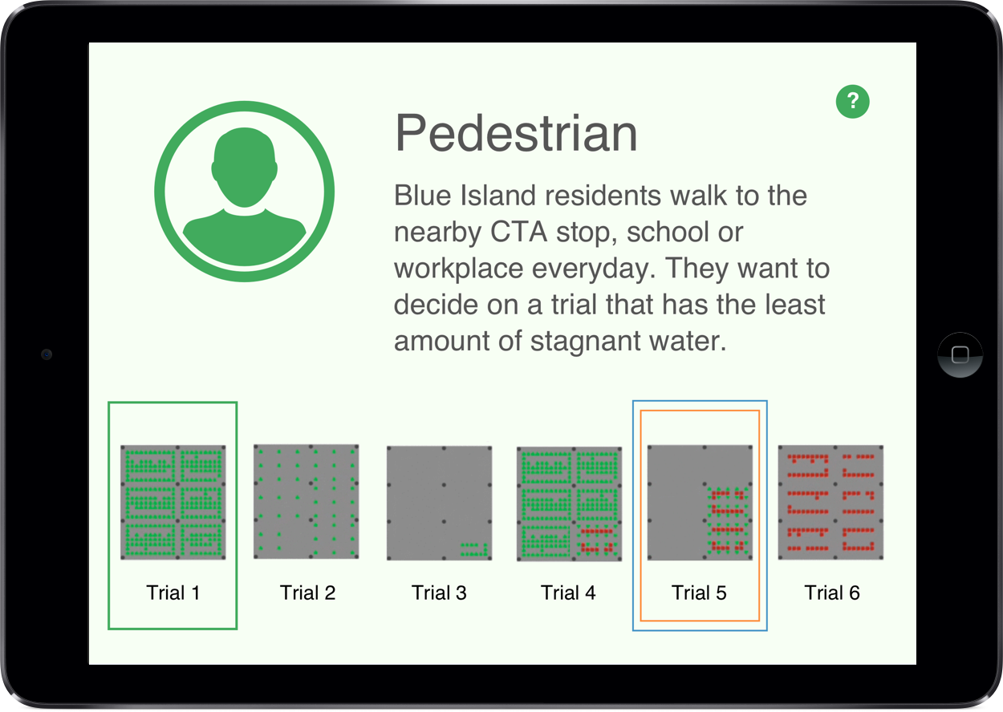
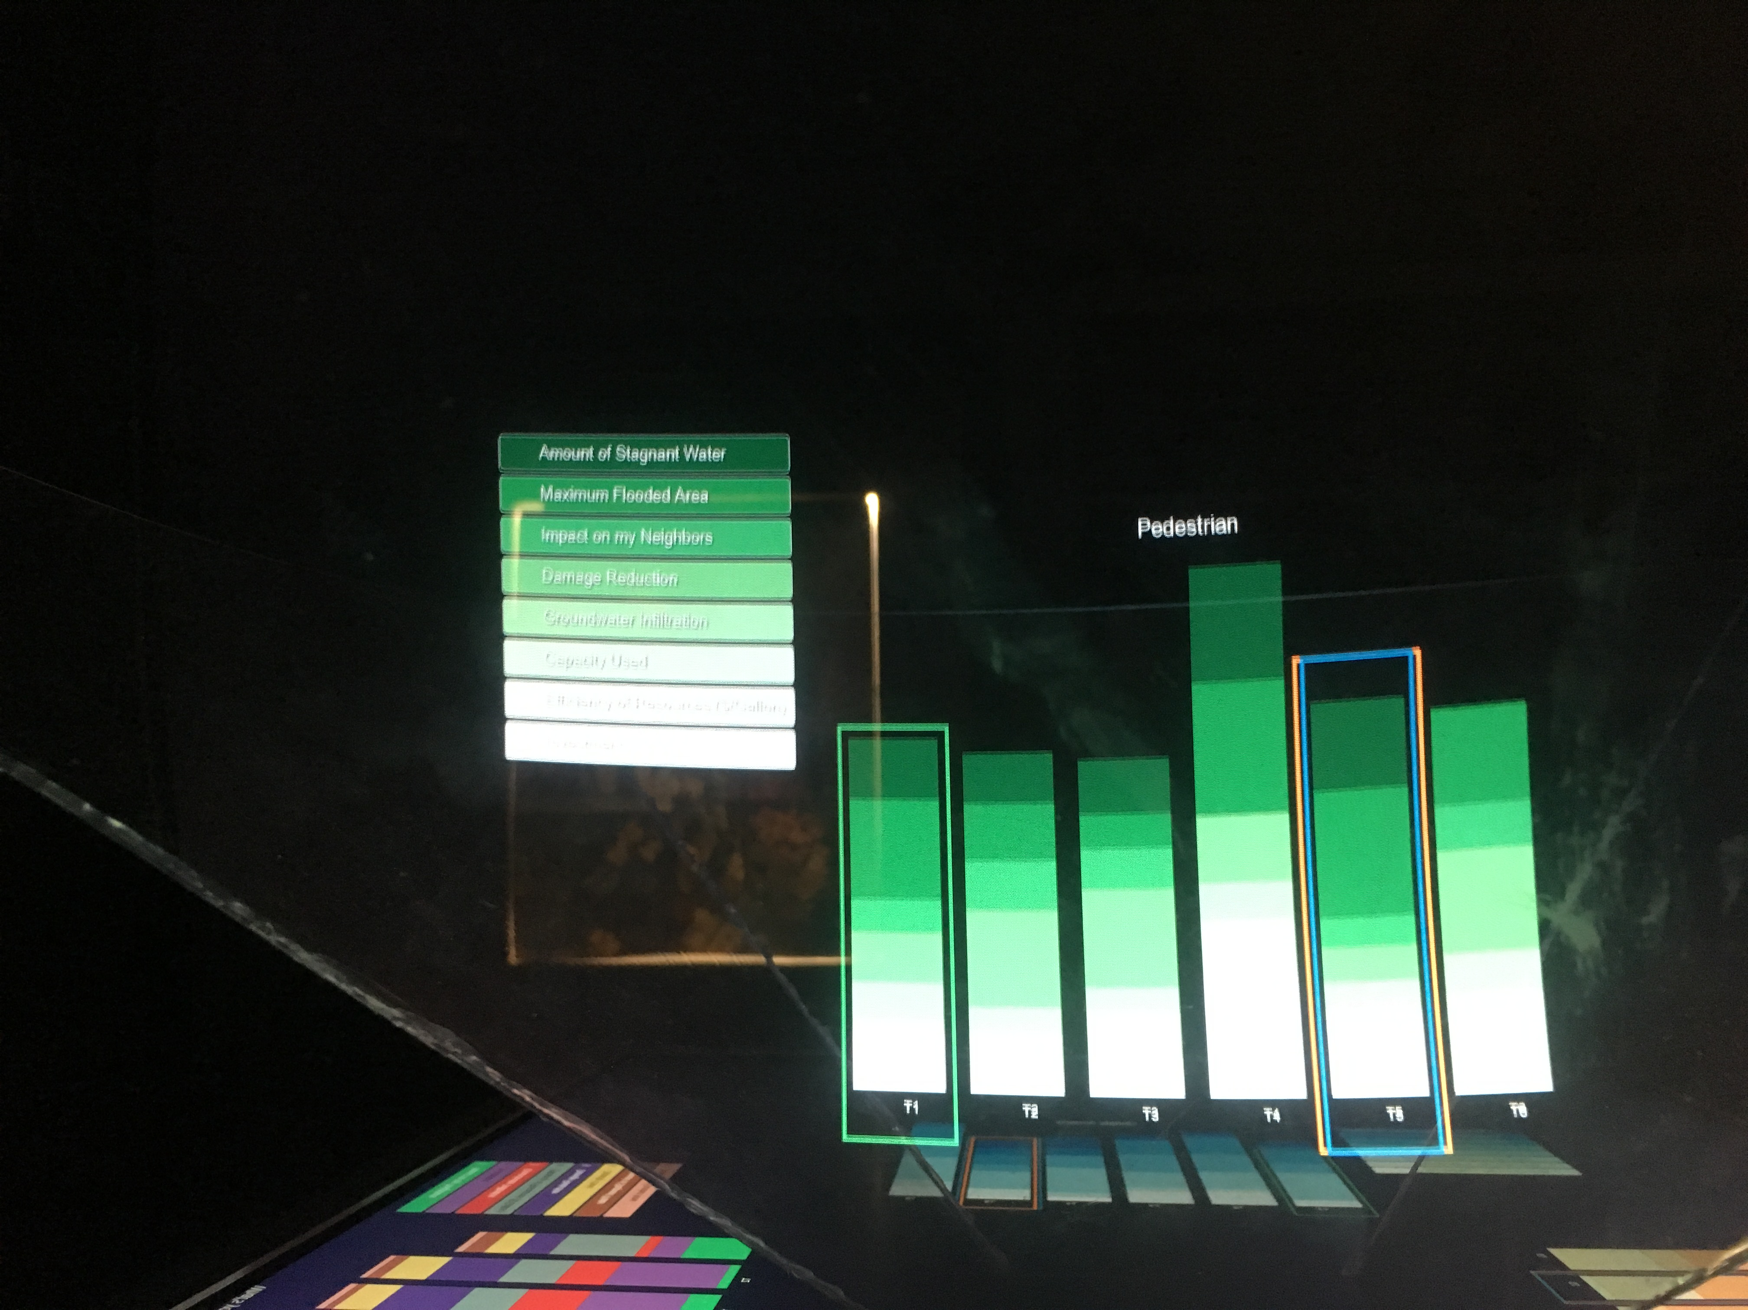
Role - Pedestrian

Slide 8
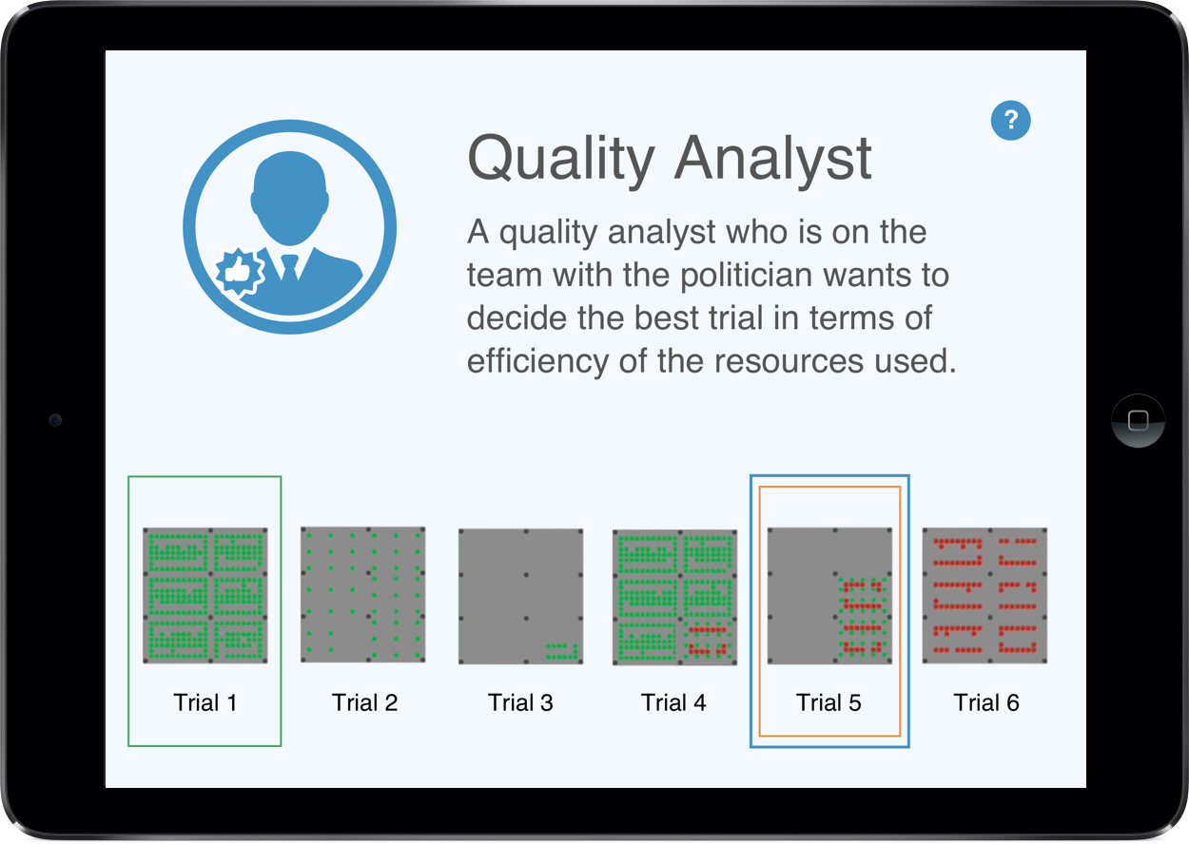
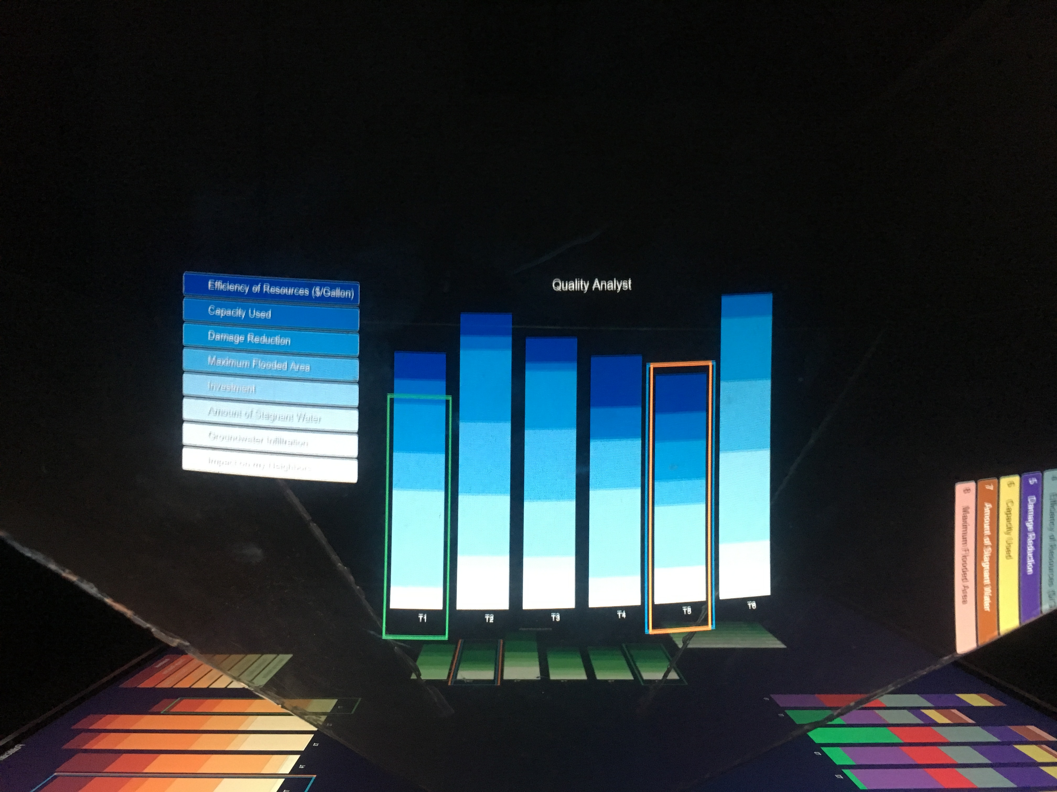
Role - Quality Analyst

Slide 9
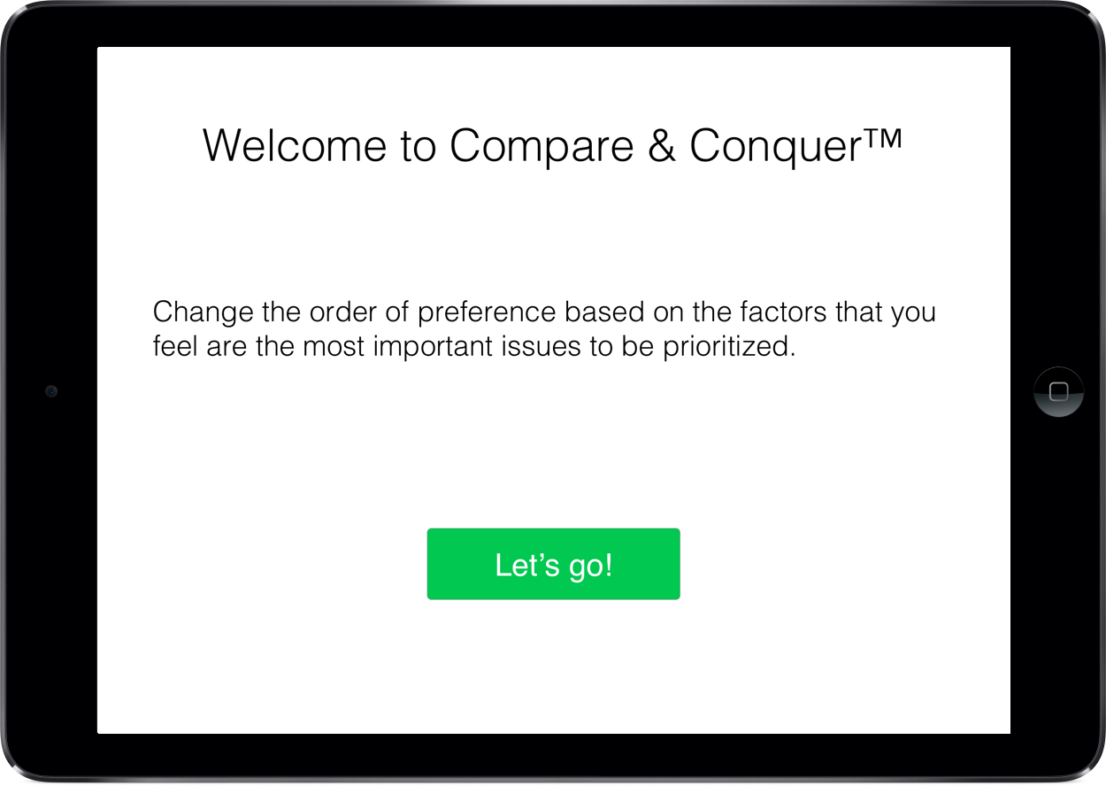
Start screen on iPad (Priorities side)

Slide 10
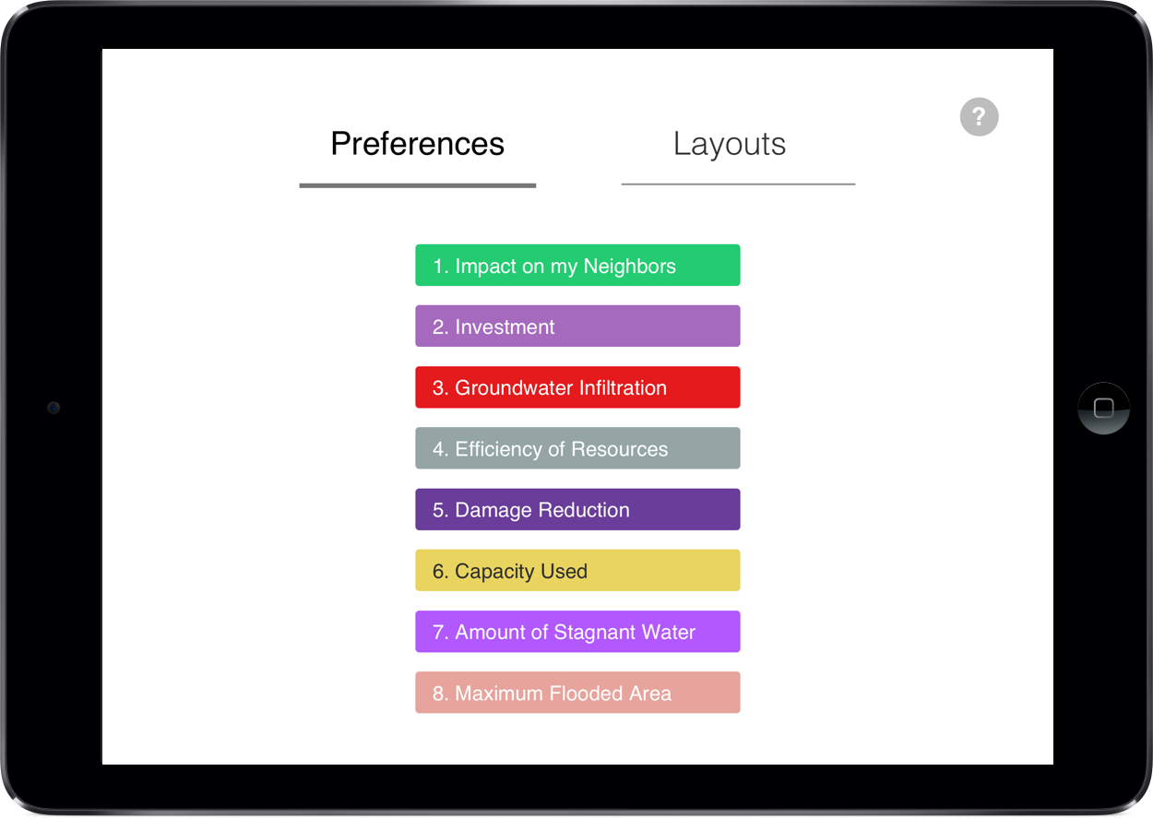
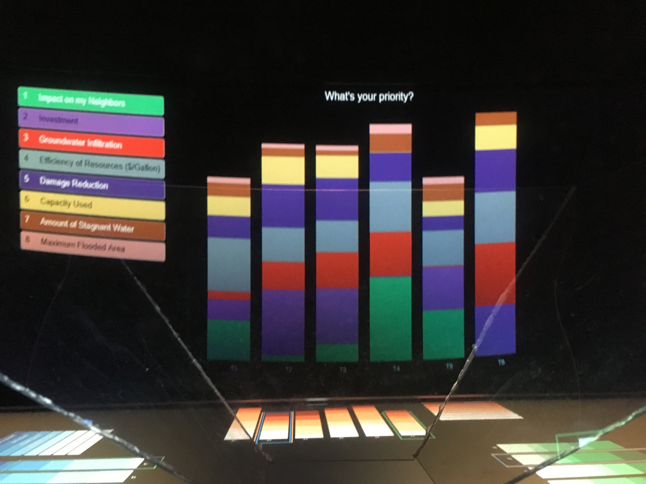
Adjusting priorities

Slide 11
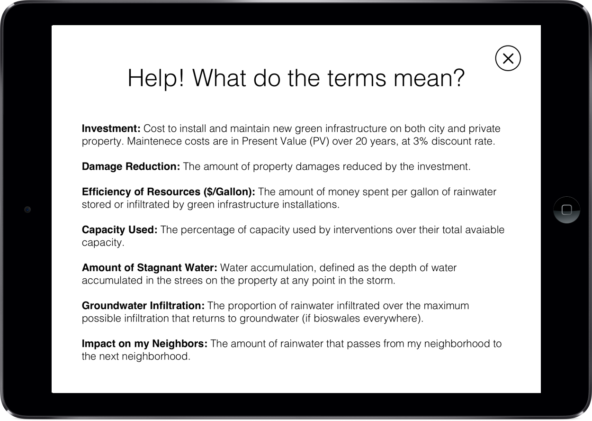
Help screen

Slide 12
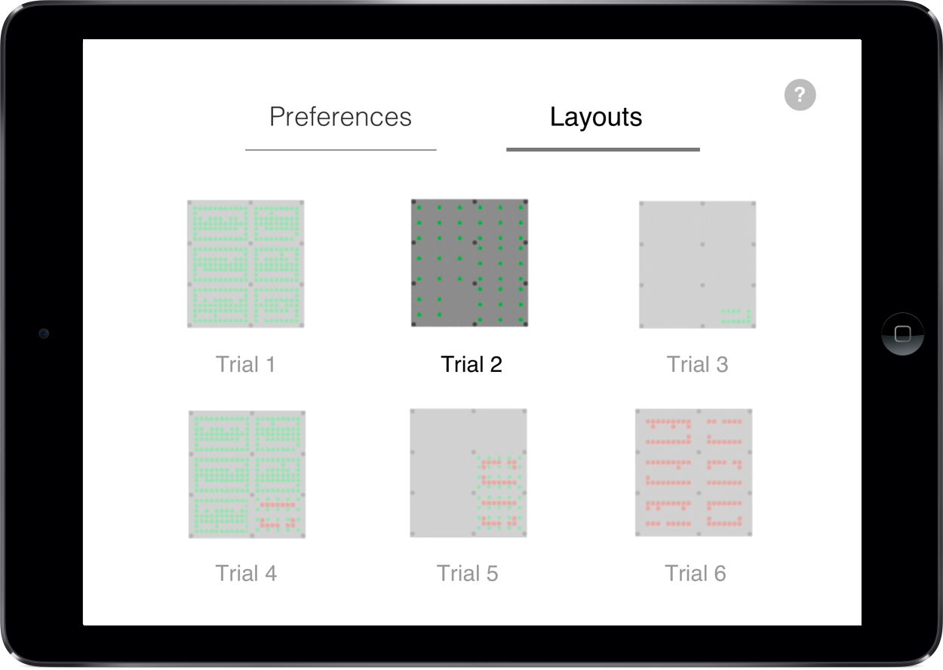
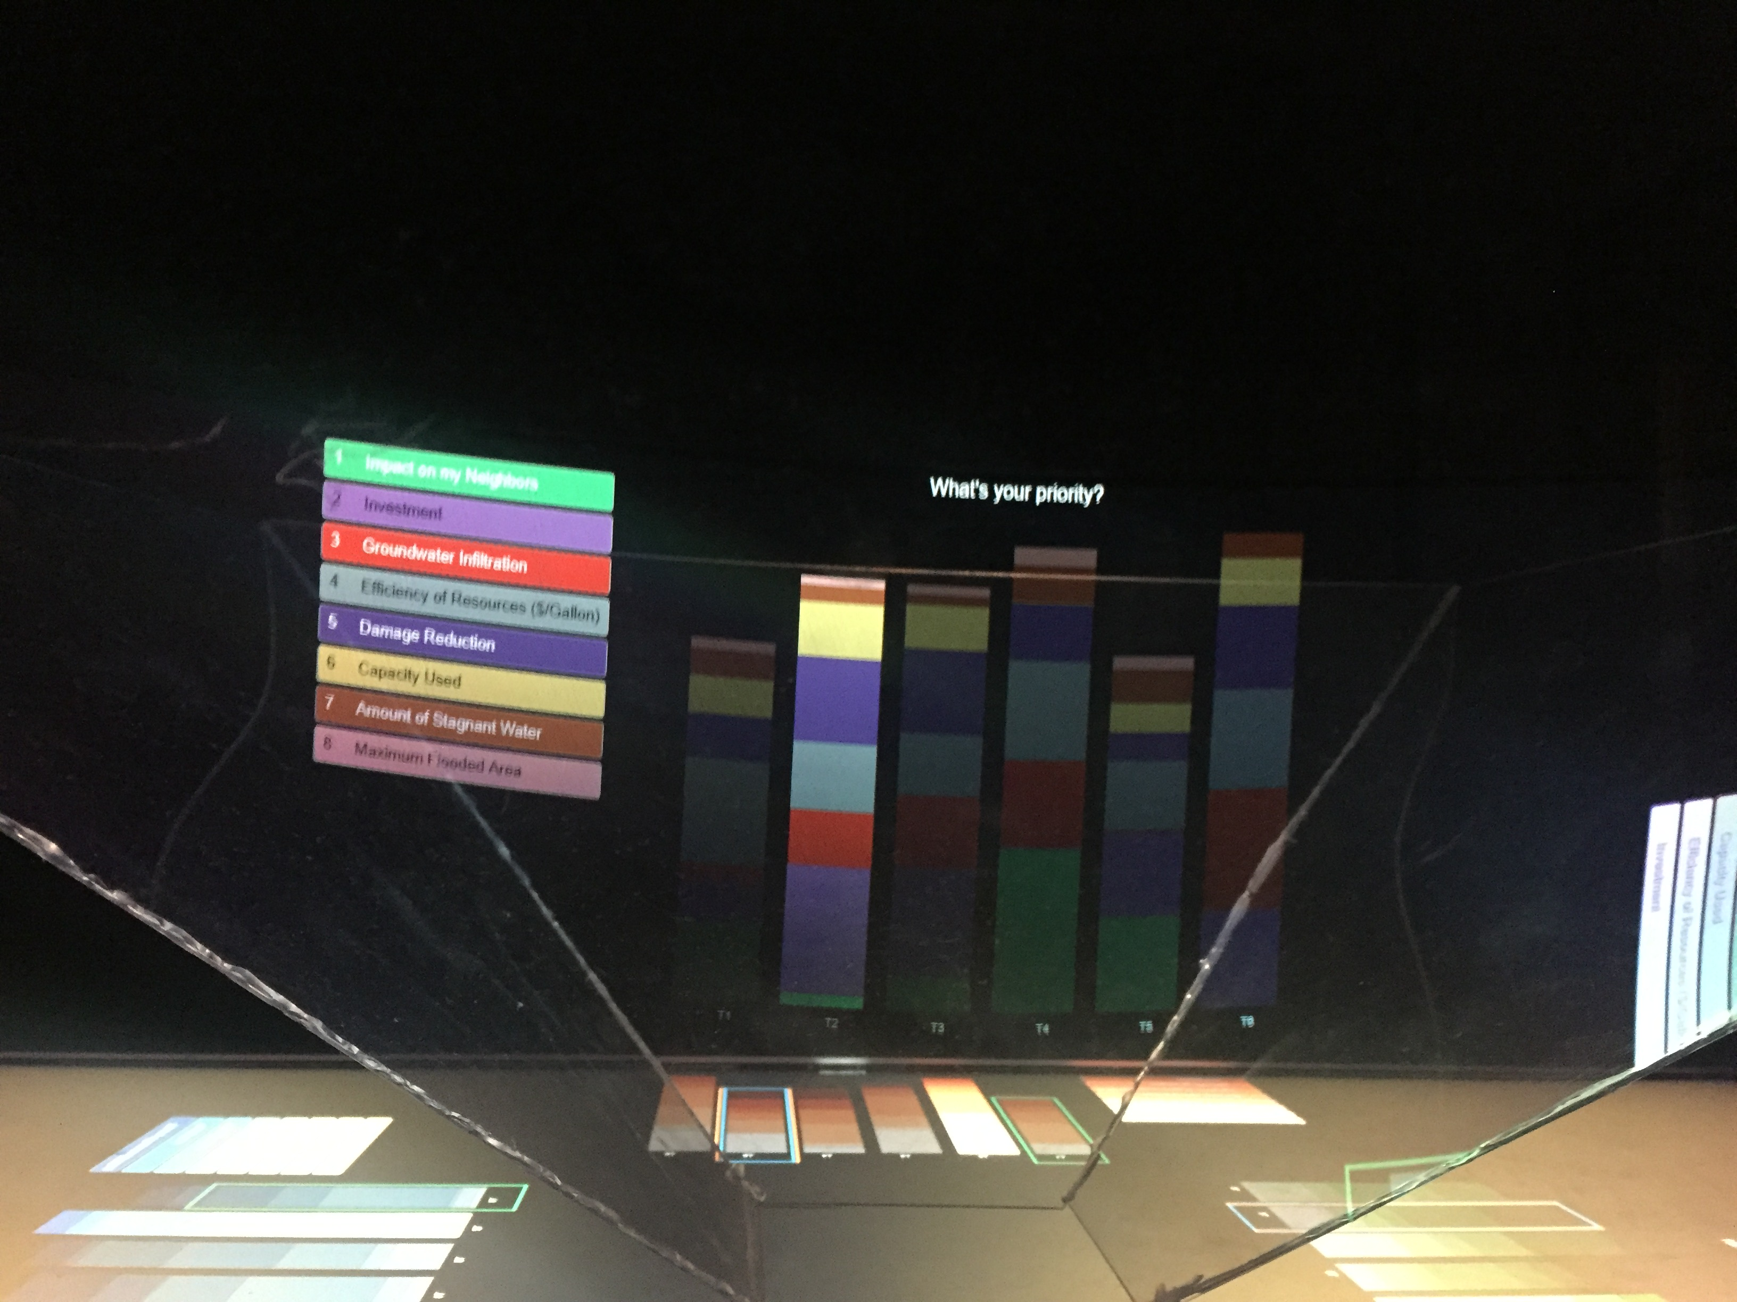
Preset trials

Slide 13
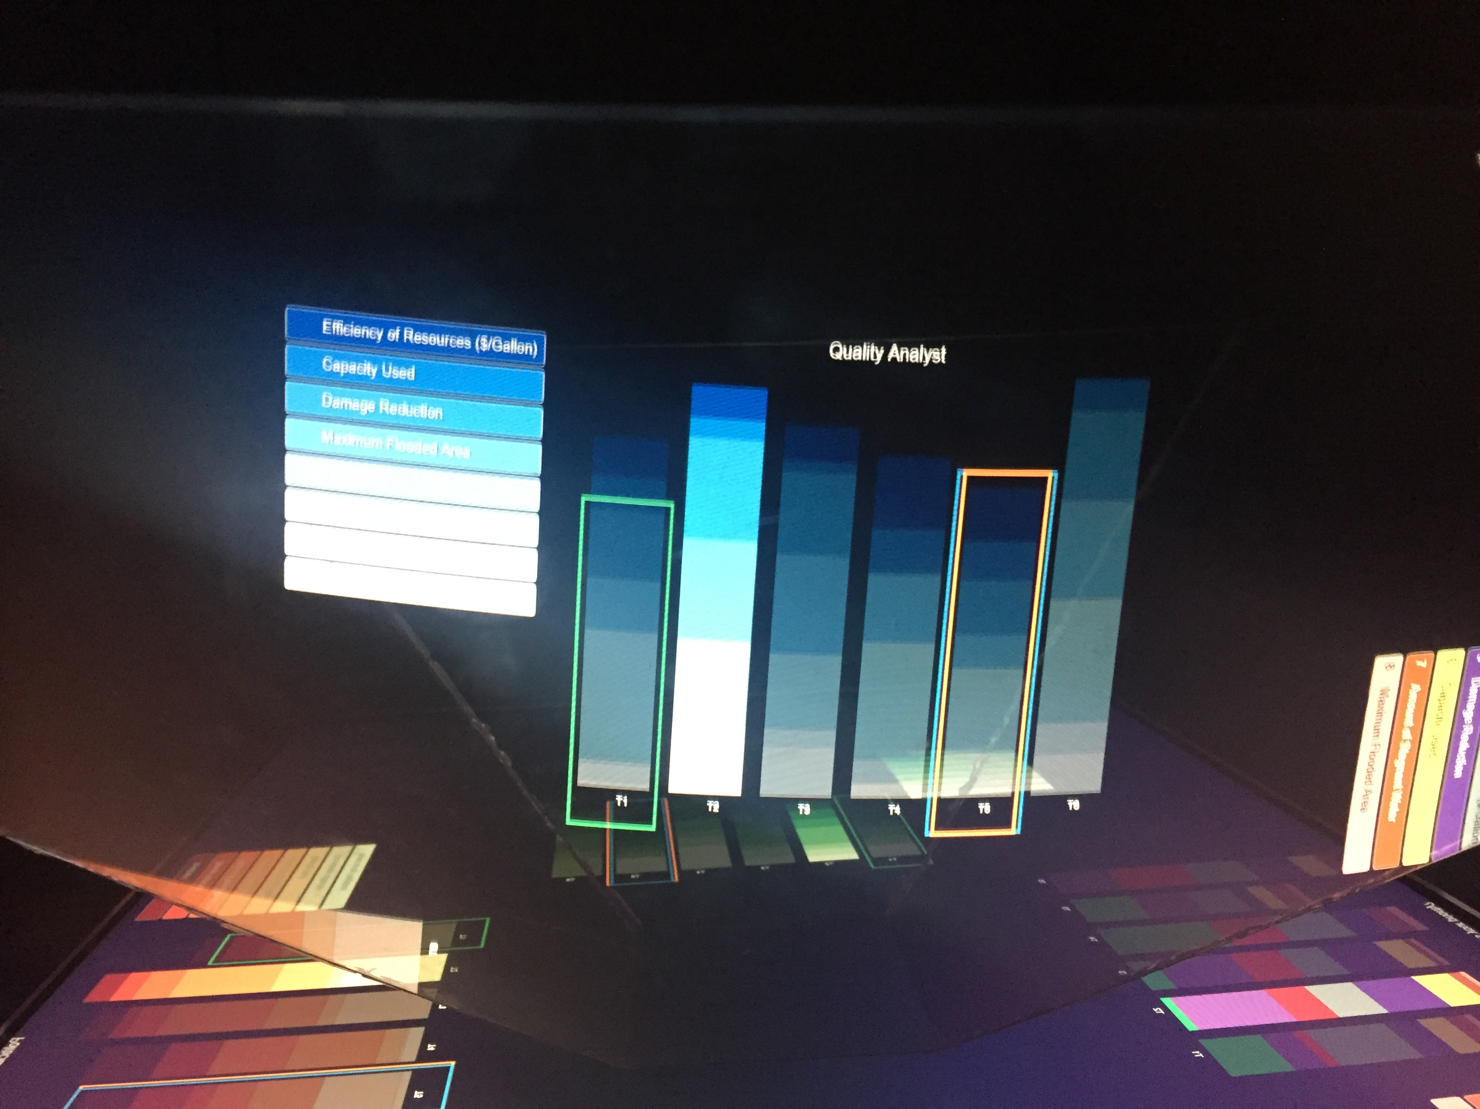
On pedestrian side..

Slide 14
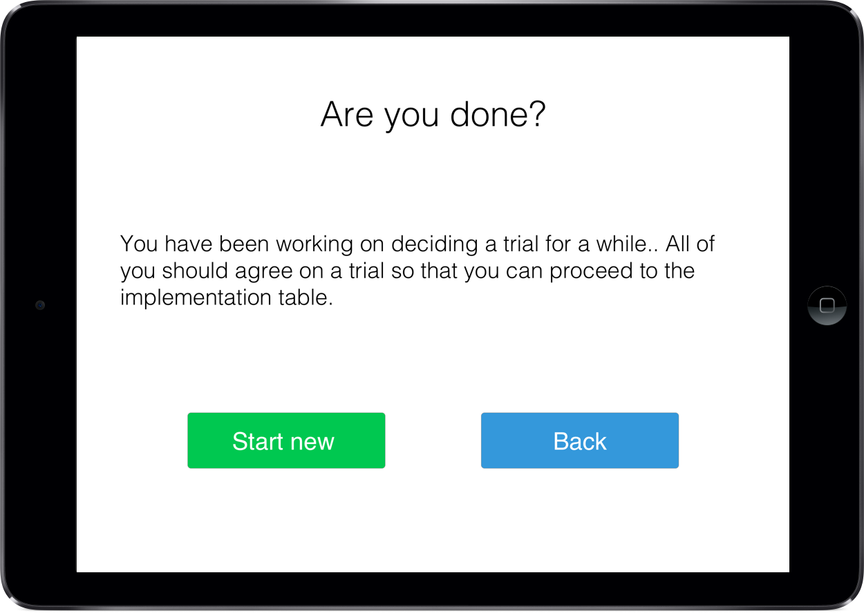
Prompt after a while..

Slide 15
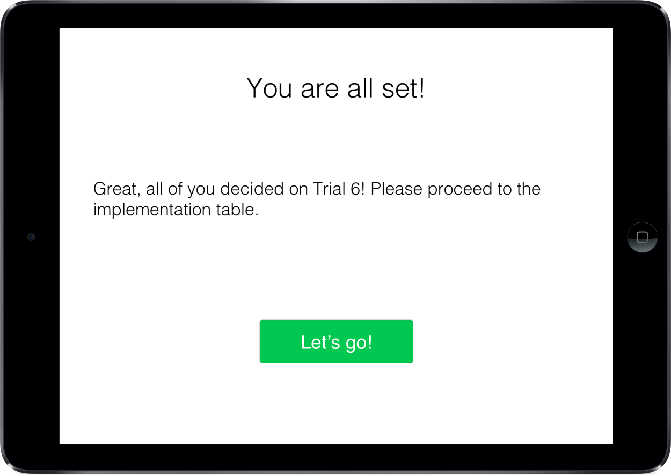
After deciding on a trial..

Slide 16
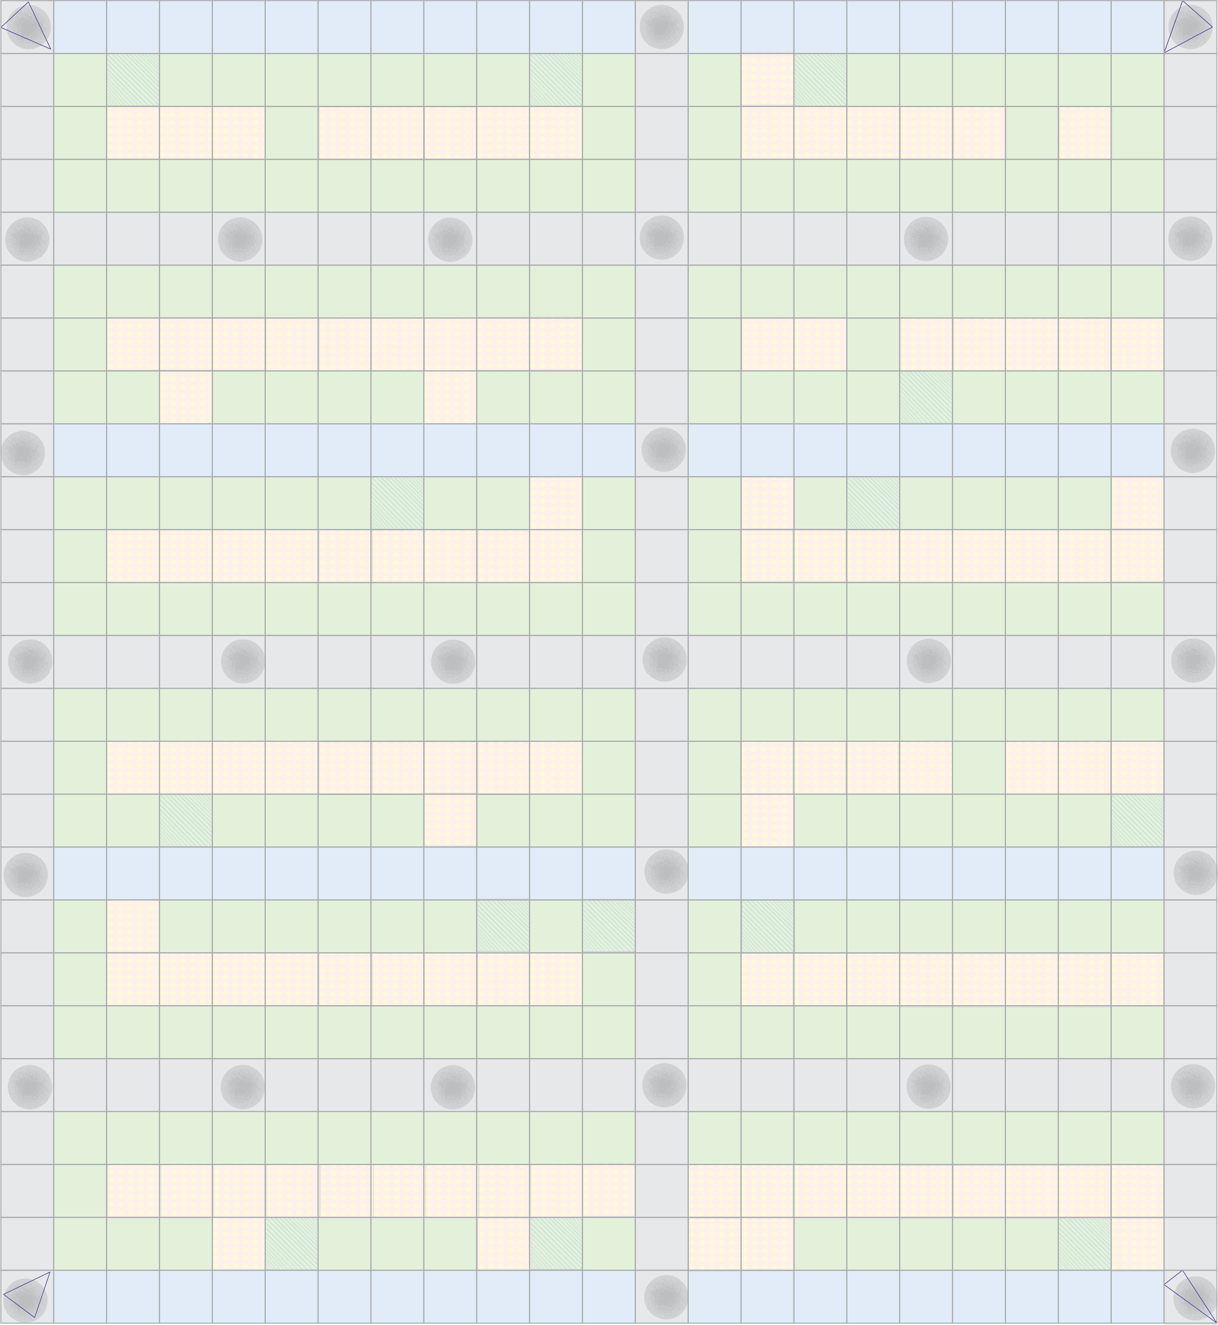
Implementation Table
You selected trial 6..
You can now implement the selected trial on implementation table by placing the tokens.
Display

Slide 17
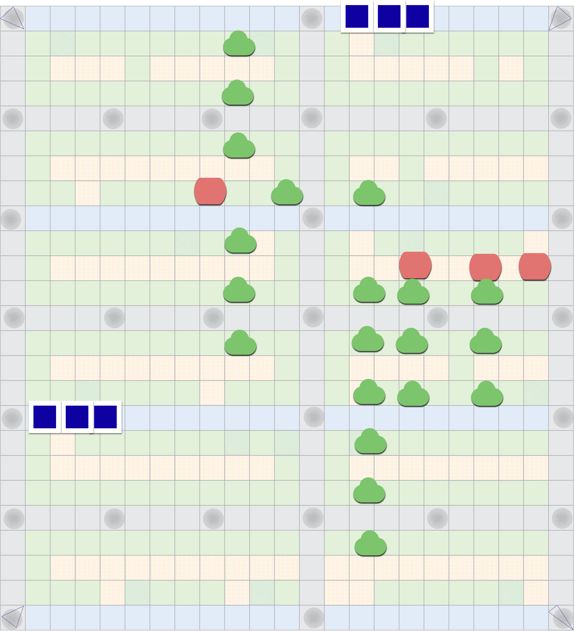
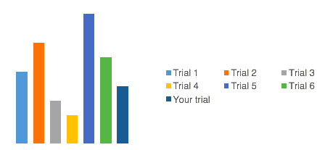
Implementation Table
You selected trial 6..
Performance
Display

Slide 18

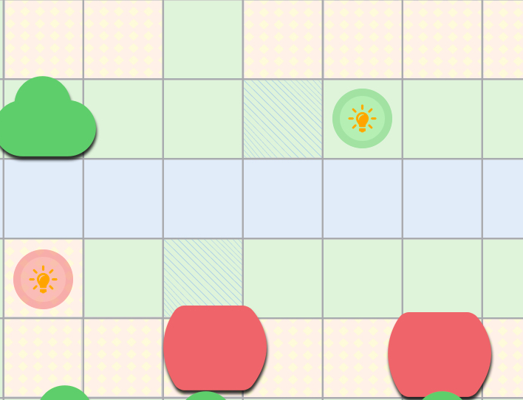
Hint Screen
Glowing hints to help place the tokens.
This hint screen is displayed for 5 seconds to help user beat the performance of the preset trials.
Display
Close up of the hints

Slide 19
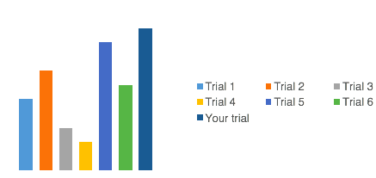
Implementation Table
You selected trial 6..
Higher than the others
Performance
Display

Slide 20
Display
Performance
Congratulations! Your trial performed better than all the other trials!!

Slide 21
THANK YOU

